Slide 1
Thinning---Templat-To-Lookup table
杨伟光
2015-09-24

Slide 2
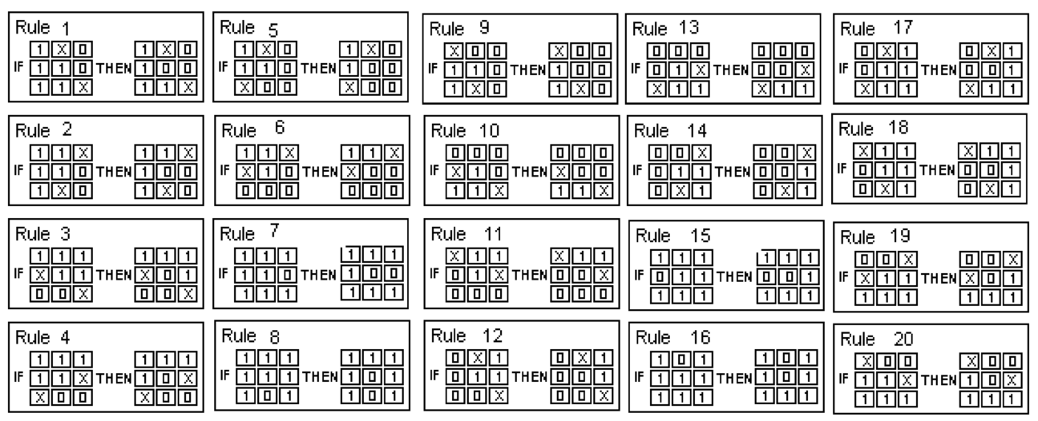
An Rotation Invariant Rule-Based Thinning Algorithm
Ahmed M, Ward R. A Rotation Invariant Rule-Based Thinning Algorithm for Character Recognition[J]. IEEE Transactions on Pattern Analysis & Machine Intelligence, 2002, 24(12):1672-1678.

Slide 3
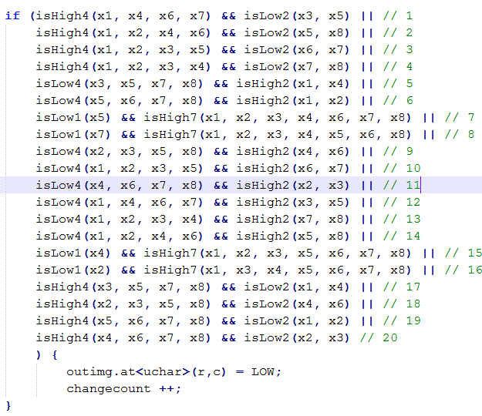
Host Code-Match 20 Templates

Slide 4
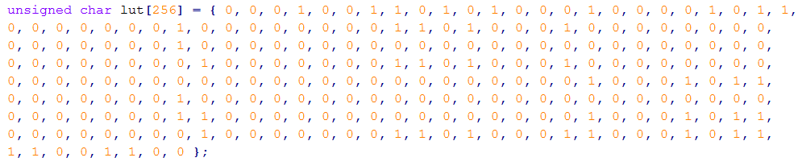
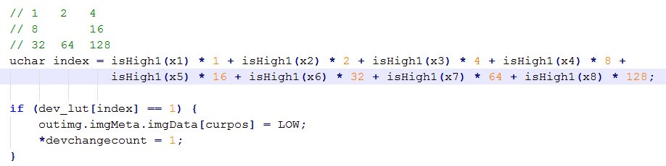
Templat-To-Lookup table

Slide 5
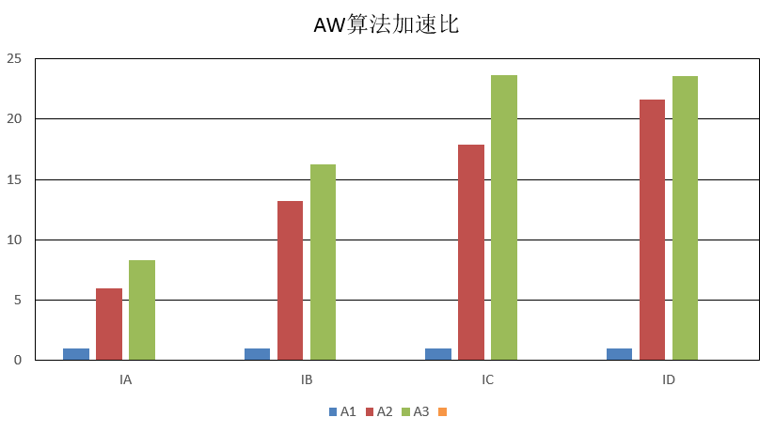

Slide 6
Thanks

